Slide 1

Chapter 11

Slide 2
What is Perfect Competition
An industry which consists of:
Many sellers and buyers
Identical goods are being sold
No barriers to entry in the markets
Notes:
Each seller is small compared to the size of the market. Eg. If I don't buy rice for a month and my demand shifts due to changes in preference, it won't have any impact on the market of rice, i.e., the market price will not change.
If you want to start a business, you can easily do it. There's nothing that stops you from starting the business.

Slide 3
Price Taker
Buyers & sellers in a perfectly competitive markets are price takers
They cannot influence the market price
That does not mean the price will not change
The price will change but the buyers/ sellers take that as given

Slide 4
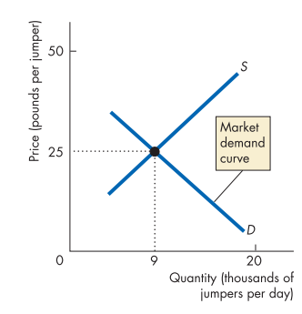
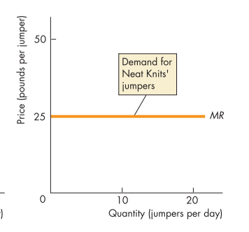

Firm's vs Market Demand
The demand that a firm faces is perfectly elastic
S-D curve of a jumper industry (Market S-D)
Individual Demand of a jumper producer

Slide 5
How can the demand for Neat Knits’ jumpers be perfectly elastic while the market demand for jumpers is not perfectly elastic?
The answer is that the elasticity of demand depends on the closeness of substitutes for a good. Neat Knits’ jumpers are perfect substitutes for other firms’ jumpers but jumpers in general are not perfect substitutes for other goods and services

Slide 6
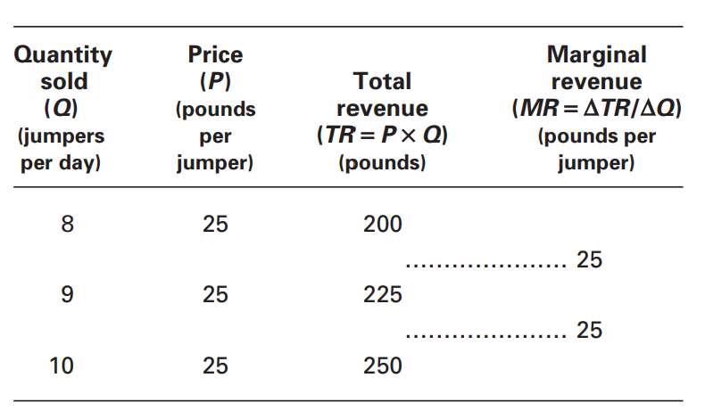
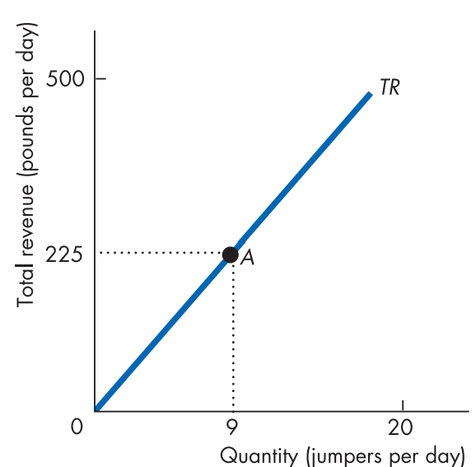
Revenue in perfectly competitive firm
Profit of a firm= TR-TC
How does total revenue behave?
In perfect competition, marginal revenue equals price

Slide 7
The firm's decision in a PC market
What is the goal of a PC firm?
To make economic profit
To achieve this objective, a firm must make four key decisions, two in the short run and two in the long run.
Two key decisions that a firm make in the short run are:
Whether to produce or to temporarily shut down
If the decision is to produce, what quantity to produce
Two key decisions that a firm make in the long run are:
Whether to increase or decrease their plants size
Whether to remain in an industry or leave it

Slide 8
Profit maximizing output
A perfectly competitive firm maximizes economic profit by choosing its output level
How to find the output level that maximizes economic profit of a firm? (Remember, economic profit=TR-TC)
Study a firm’s total revenue and total cost curves and find the output level at which total revenue exceeds total cost by the largest amount

Slide 9
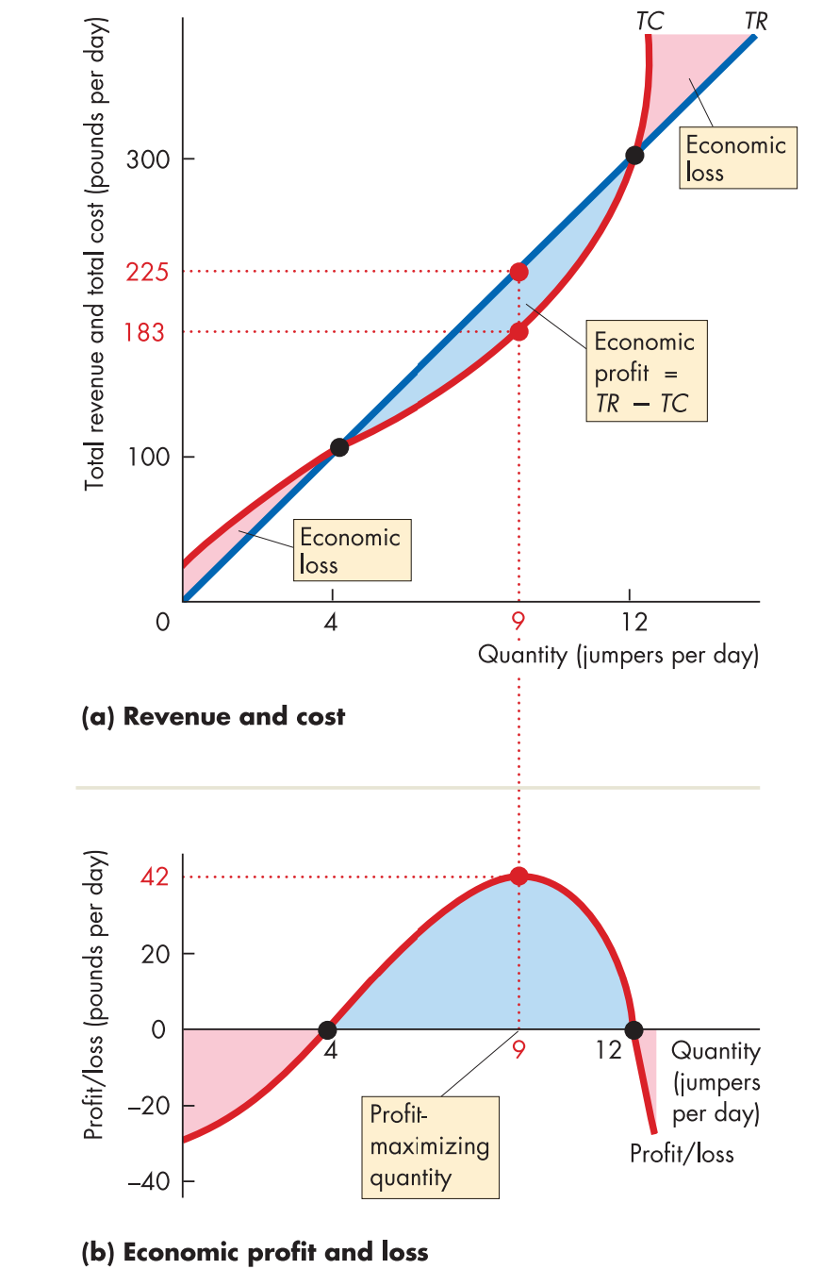
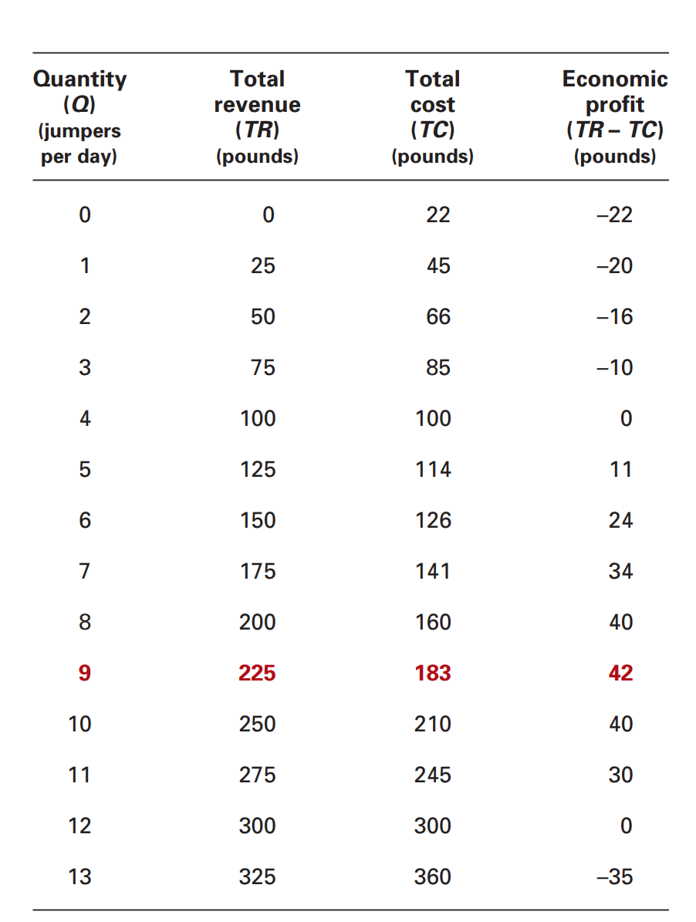
TR, TC, & Economic profit

Slide 10
Looking back at the graphs, which level of output will the firm produce to maximize profit?
The profit curve is at its highest when the distance between the total revenue and total cost curves is greatest.
Profit maximization occurs at an output of 9 jumpers a day. At this output, Neat Knits makes an economic profit of £42 a day
At which level of output is the firm making zero profit? Does the firm still operate at that level?
Within which level, will the firm decide to not operate?

Slide 11
Marginal Analysis
Another way of finding the profit-maximizing output is to use marginal analysis, by comparing marginal cost, MC, with marginal revenue, MR
As output increases, marginal revenue remains constant but marginal cost changes
If MR > MC, then the extra revenue from selling one more unit exceeds the extra cost incurred to produce it. The firm makes an economic profit on the marginal unit, so economic profit increases if output increases
If MR < MC, then the extra revenue from selling one more unit is less than the extra cost incurred to produce it. The firm incurs an economic loss on the marginal unit, so its economic profit decreases if output increase
If MR = MC, the firm makes maximum economic profit. The rule MR = MC is an example of marginal analysis.

Slide 12
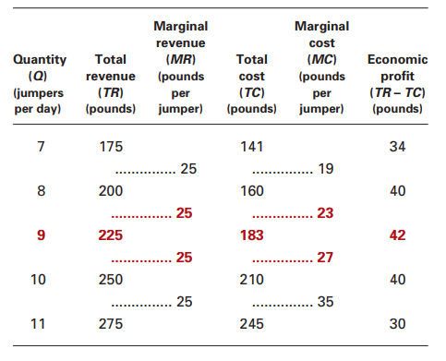
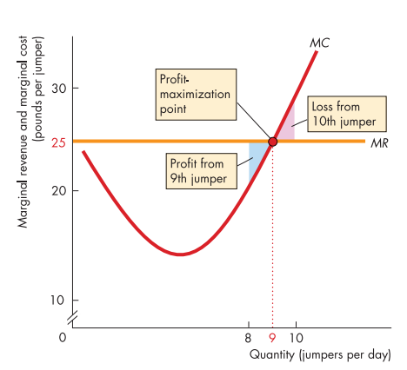

Slide 13
Does this mean that the price-taking firm’s production decision can be entirely summed up as “produce up to the point where the marginal cost of production is equal to the price”
Before applying the principle of marginal analysis to determine how much to produce, a potential producer must as a first step answer an “either–or” question: should it produce at all?
We need to determine whether it is profitable or unprofitable to produce at all

Slide 14
Profits & Losses in the SR
We know, Economic Profit=TR – TC
If the firm produces a quantity at which TR > TC, the firm is profitable
If the firm produces a quantity at which TR = TC, the firm breaks even
If the firm produces a quantity at which TR < TC, the firm incurs a loss
To calculate profit per unit of output, divide by the number of units of output, Q, produced:
Profit/Q = TR/Q − TC/Q
Profit per unit of output
Average Total Revenue
Average Total Cost

Slide 15
Profit/Q = TR/Q − TC/Q
Average revenue=Marginal Revenue = Market price (Calculate AR from the previous table)
Profit per unit = P − ATC
Economic profit (or loss)= (P – ATC) * Q
How can you determine a firm's profit outcome from the market price?
If the firm produces a quantity at which P > ATC, the firm is profitable
If the firm produces a quantity at which P = ATC, the firm breaks even
If the firm produces a quantity at which P < ATC, the firm incurs a loss.

Slide 16
